Slide 1
Lecture on
Stridor and tracheostomy
By Dr.Mariwan latif fatah
M.B.ch.B F.I.C.M.S

Slide 2
Stridor:
A harsh, high pitched musical sound that results from turbulent airflow through a partially obstructed airway.
Etiology may range from mild illness to severe, life-threatening situation

Slide 3
Types of stridor
Inspiratory stridor:
It is often produced in obstructive lesion of supraglottis or pharynx.
Expiratory stridor:
It is produced in lesion of thoracic trachea and bronchi.
Biphasic stridor:
It is seen in lesion of glottis , subglottis and cervical trachea.

Slide 4
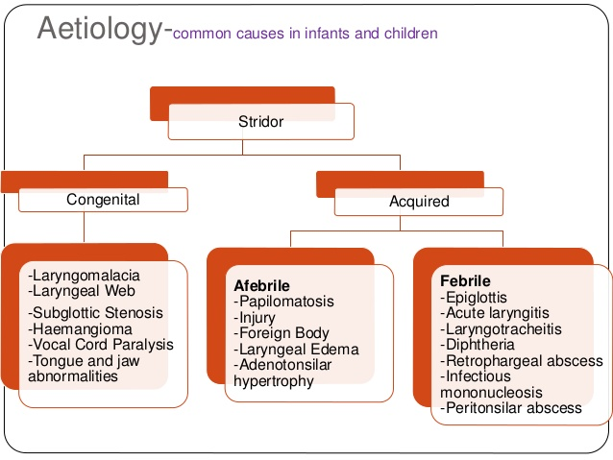
Common causes of stridor in infant and chlidren

Slide 5
Diagnosis
History & Examination
Flexible fiberoptic laryngoscopy
Direct laryngoscopy with rigid bronchoscopy
Barium esophagram
CT neck and chest

Slide 6
MANAGEMENT
 Maintain Airway
 Positioning of neck and body
 Supplemental Oxygen as needed
 Stridor has varied etiology hence specific management depends on the cause.

Slide 7
Tracheostomy

Slide 8
Tracheotomy
is the term used to describe the surgical opening of the trachea.
Tracheostomy
is used to describe the creation of a stoma at the skin surface which leads into the trachea

Slide 9
Types of tracheostomy
Temporary tracheostomy
Temporary tracheostomy may be either elective or emergency
Permanent tracheostomy
Permanent tracheostomy is an elective procedure carried out as part of an operation involving removal of the larynx, such as a laryngectomy or laryngopharyngectomy, or as part of a diversion procedure for aspiration problems.

Slide 10
INDICATIONS
Upper airway obstruction
Removal of secretions
Prolonged ventilation
Part of another surgical procedure in the head and neck.

Slide 11
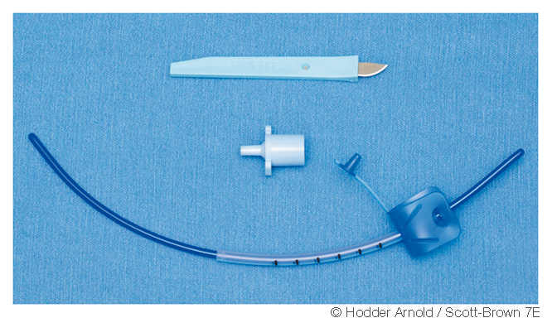
Cricothyroidotomy Minitracheostomy
In an emergency, rapid entry to the airway can be achieved through the cricothyroid membrane.
Once the cricothyroid has been breached the airway can be maintained either with a minitracheostomy tube or a large-bore cannula.

Slide 12
Technique
Percutaneous tracheostomy(minimally invasive)
Open tracheostomy.

Slide 13
Open surgical technique
The should be positioned on the operating table, with a sandbag under the shoulders for neck extension.
The surface anatomy should be marked on the skin surface to highlight the position of the lower border of the cricoid cartilage and the suprasternal notch.
The horizontal incision is sited midway between these landmarks.
It is useful in elective cases to infiltrate the incision line with adrenaline to aid haemostasis

Slide 14
In a true emergency tracheostomy it is useful to employ a midline vertical incision and cut down directly onto the surface of the trachea, thus gaining rapid control of the airway.
The skin and subcutaneous tissues are divided horizontally to the depth of the strap muscles.
The strap muscles are separated vertically by blunt dissection in the midline.
thyroid isthmus is identified, and this should be divided between clamps and the ends oversewn.

Slide 15
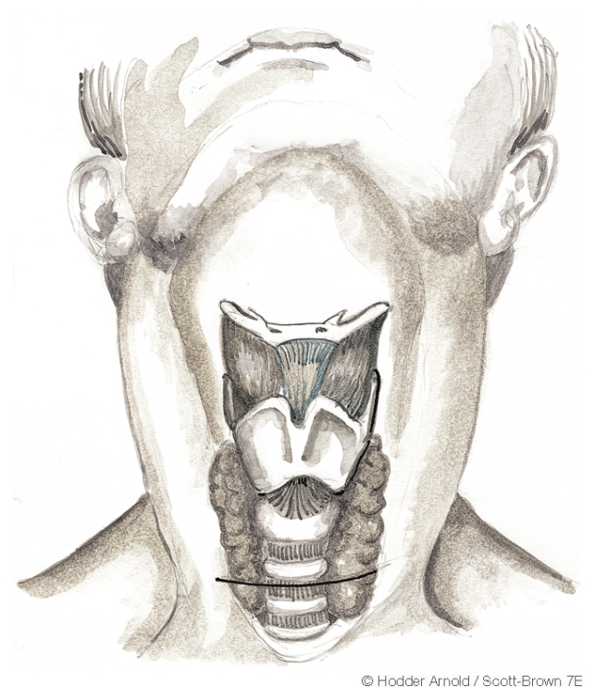
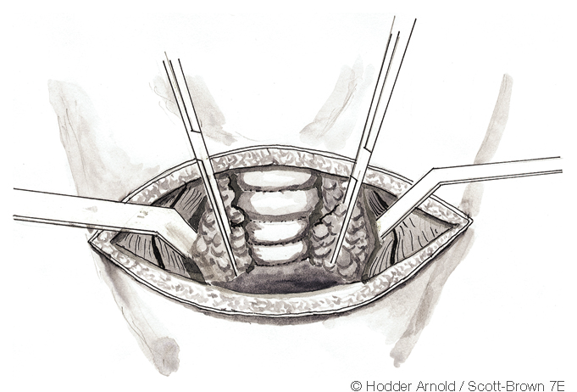
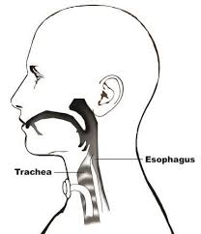
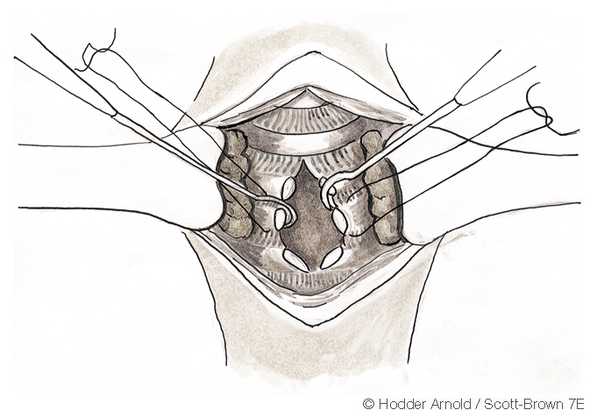

Slide 16
Following division of the thyroid isthmus, the trachea is visible, at which point it is useful to identify the cricoid cartilage and palpate each of the tracheal rings to determine the best position for the tracheotomy to be made.
In general, the incision should be through the second to fourth tracheal rings. It is important to refrain from causing any damage in the region of the cricoid cartilage as this may result in an increased incidence of postoperative subglottic stenosis.

Slide 17
An exception to this rule is when a patient has a laryngeal malignancy, and under these circumstances the tracheotomy should be placed high so as to allow resection of the tracheotomy site at the time of laryngectomy.
The tracheostomy tube having been inserted, the endotracheal tube can be removed and the ventilator can be connected to the tracheostomy tube.
The incision should be closed loosely with sutures to prevent the formation of surgical emphysema, and the tracheostomy tube should be sutured in position.

Slide 18
Types of tracheostomy tube:(Features)
Cuffed tube.
Un cuffed tube.
Inner tube.
Fenestration.
Flexibility. (armoured tube)
Adjustable flanges.

Slide 19
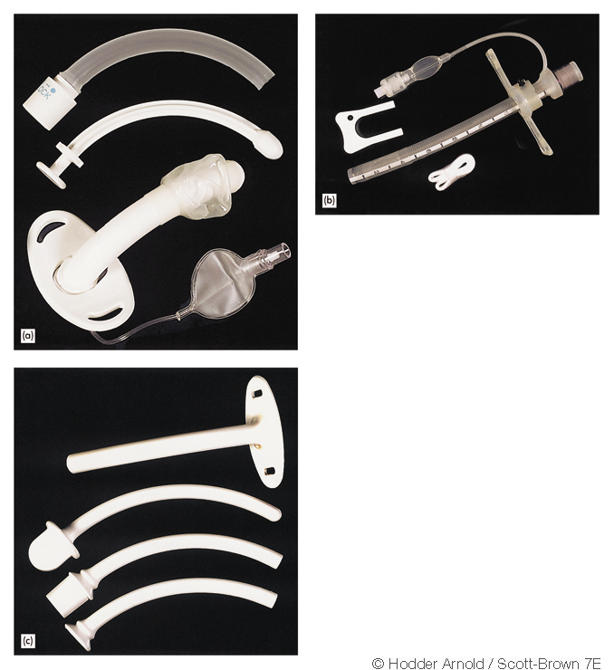
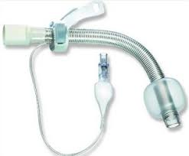

Slide 20
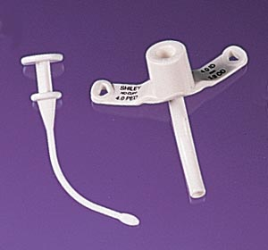
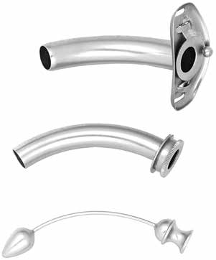
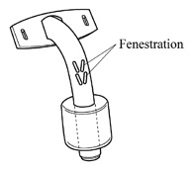
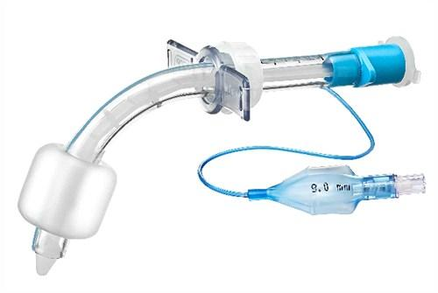

Slide 21
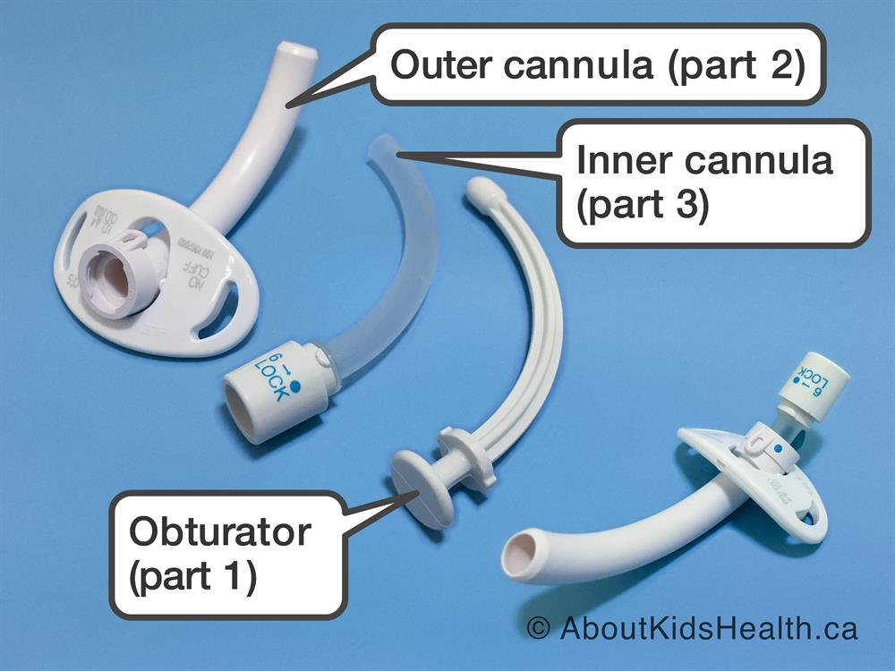

Slide 22
POSTOPERATIVE MANAGEMENT
Tracheostomy tube
Humidification and removal of secretions.
Swallowing

Slide 23
Cmplication
The complications of tracheostomy fall into the following categories:
Immediate:
anaesthetic complications
haemorrhage:
thyroid veins.
jugular veins.
arteries.
air embolism
apnoea.
cardiac arrest
local damage:
• thyroid cartilage.
• cricoid cartilage.
• recurrent laryngeal nerve.

Slide 24
Intermediate
- displacement of the tube.
- surgical emphysema.
- pneumothorax/pneumomediastinum.
- infection: perichondritis.
- tube obstruction by secretions or crusts.
- tracheal necrosis;
- tracheoarterial fistula.
- tracheo-oesophageal fistula.
- dysphagia.

Slide 25
• Long term:
- stenosis
- decannulation problems.
- tracheocutaneous fistula.
- disfiguring scar

Slide 26


